Slide 1
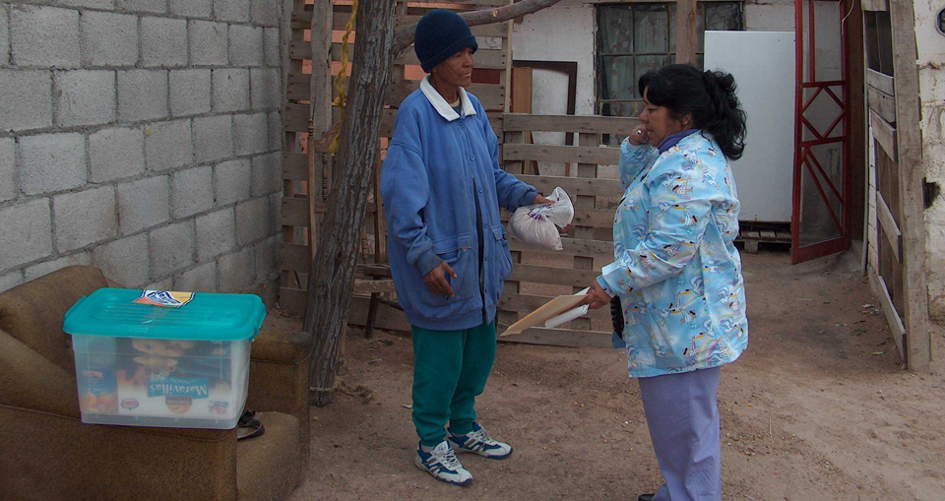
Breathe Pennsylvania: Tuberculosis Educational Conf.
April 24, 2015
Ed Zuroweste, MD
PA TB Medical Consultant
Adapted from presentation by Alfred Lardizabal, MD, c October 31st, 2012 GTBI
Understanding Latent Tuberculosis and Treatment

Slide 2
The burden of latent tuberculosis infection, the reservoir for active TB
The World Health Organization estimates that 2 billion persons worldwide (1/3 of the world’s population) has latent tuberculosis infection
  From this reservoir, millions of people will have active tuberculosis (TB) in coming decades
In the U.S., it is estimated by a recent NHANES survey that there are roughly 12 million persons with LTBI
>70% of TB disease in the US are re-activation TB

Slide 3
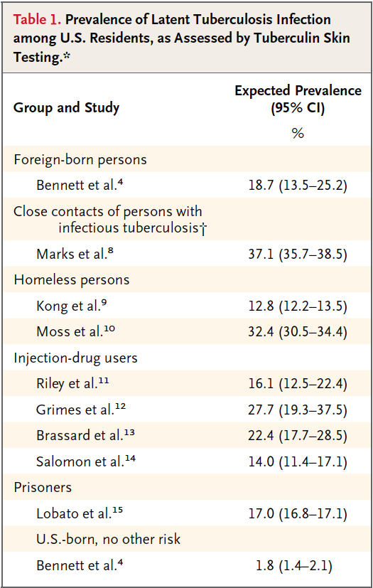
Horsburgh and Rubin
NEJM 2011

Slide 4
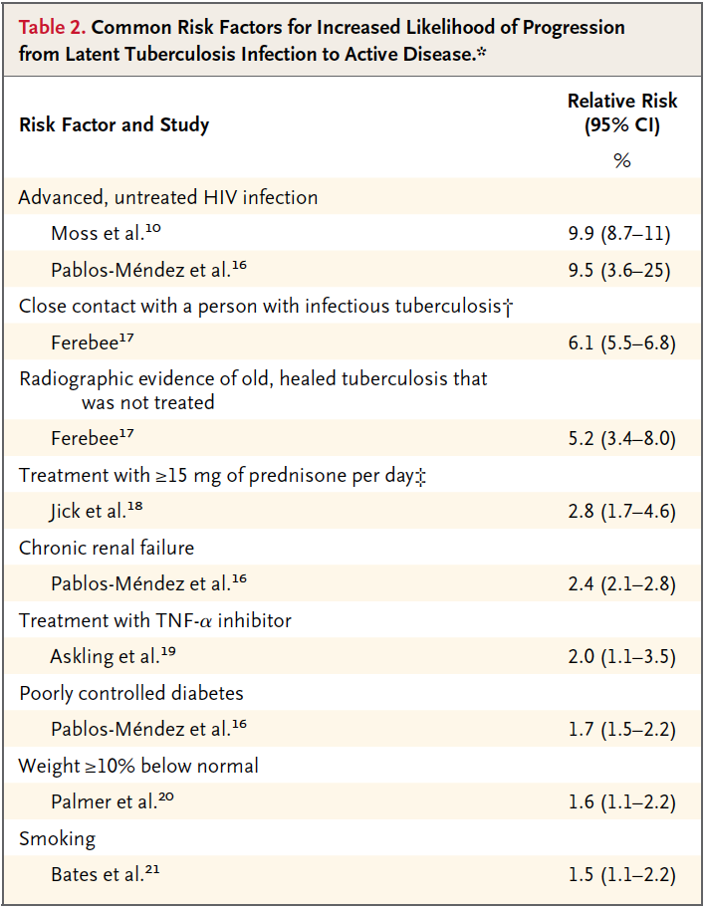
Horsburgh and Rubin
NEJM 2011

Slide 5
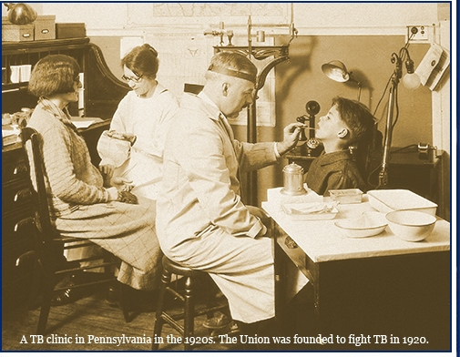
Pre-treatment Evaluation
Before initiating treatment for LTBI:
Rule out TB disease
  Wait for culture result if specimen obtained
  Assess/evaluate for symptoms
Determine prior history of treatment for LTBI or TB disease
Assess risks and benefits of treatment
  Active liver disease
Ascertain current and previous drug therapy and side effects
Notes:
5
5

Slide 6
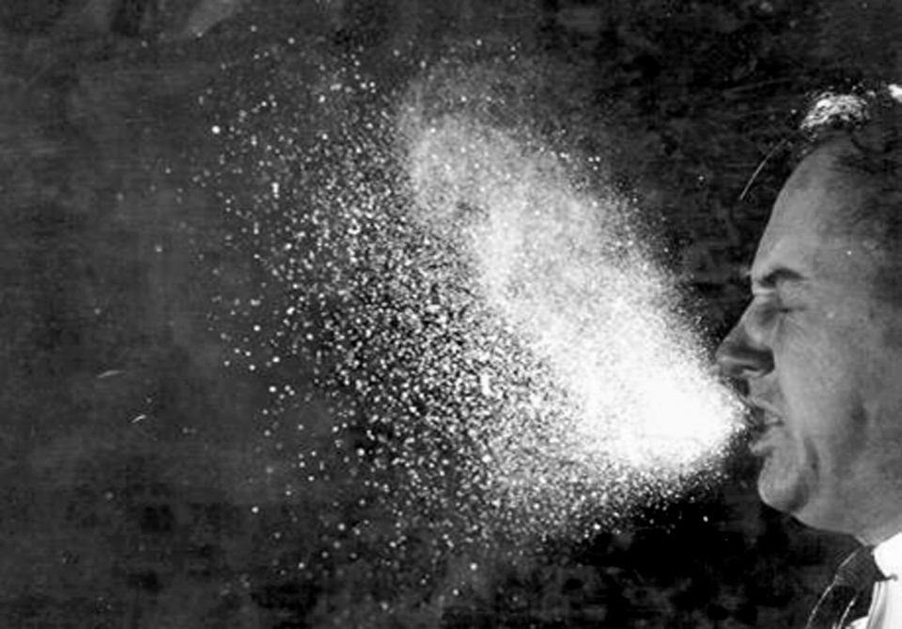
Initiating Treatment: Patient Education
Counsel and educate patient
  Discuss patient’s risk for progressing to TB disease
  Emphasize benefits of treatment
  Assess whether patient willing to be treated for full treatment period
Review common side effects
Establish treatment plan

Slide 7
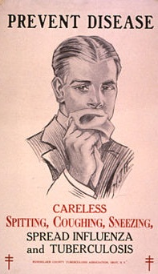
Baseline Medical Evaluation
Medical history
  History of TB or HIV treatment
  TB exposure
  Risks for drug toxicity (e.g., alcoholism, liver disease, pregnancy)
  Complete medication list
Chest x-ray: Rule out TB disease
Laboratory tests
  CBC and LFTs, if indicated
  3 sputum samples for AFB smear, culture, & sensitivities if TB symptoms or CXR findings
Notes:
7
7
Lab tests – only if indicated

Slide 8
Treatment Regimens for LTBI
Drugs | Months of Duration | Interval | Minimum Doses | Rating/ Evidence
INH | 9* | Daily | 270 | AII
 |  | 2x wkly** | 76 | BII
INH | 6 | Daily | 180 | BI
 |  | 2x wkly** | 52 | Avoid: HIV infected, children (CII)
RIF | 4 | Daily | 120 | BII
*Preferred ** Intermittent treatment only with DOT INH=isoniazid; RIF=rifampin
Notes:
8
8
8
Please explain why INH for 9 mos. is preferred regimen (based on rating system, AII rating). They will get a more detailed explanation on the rating system in the TB Disease lecture to follow your talk;
Advantages:
80% effective
Inexpensive
Universally available
Disadvantages
9 months duration
Very poor treatment completion rates
Adverse effects common

Slide 9
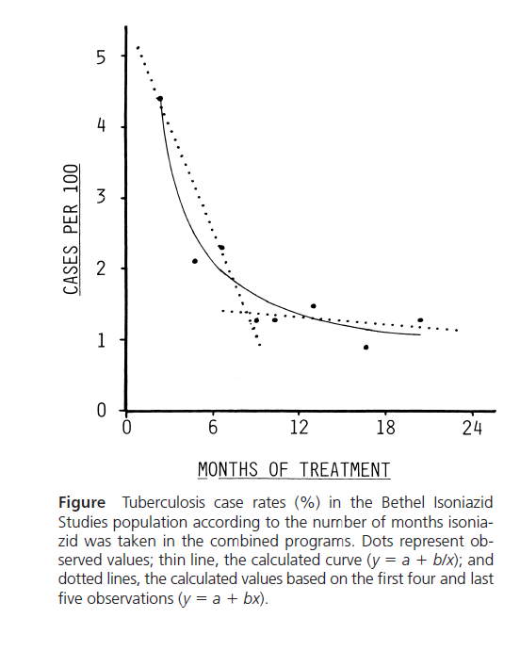
How Much INH is Needed for Prevention of TB?
Longer duration corresponded to lower TB rates
No extra increase in protection if took >9 mo
Comstock GW, Int. J Tuberc Lung Dis 1999;3:847-50
Notes:
9
How much INH is needed for prevention of TB-graph)
Comstock studied a community in Bethel Alaska to see how much INH would be needed for adequate prevention. It was noted for those persons who took < 25 % of the prescribed annual dose, they would have a threefold higher risk for TB than those who took > 50% of the annual dose. Further analysis of the data indicated that the efficacy of prevention decrease significantly if < 9 months of INH were taken. Therapy beyond 9 months did not afford additional benefit.
(From ending neglect PP18- Tx of persons with LTBI can greatly reduce the incidence of TB. A series of clinical trials has shown the effectiveness of inh ranging from 92% in preventing active TB in patients when adherence is high, to 26% when adherence is low(Ferebee, 1970). A study of 3, 6 and 12 month regimens showed that a 12 month regimen was optimal, but additional analysis indicates that a regimen of at least 9 months gives nearly as much protection as a regimen of 12 months (IU against TB committee on prophylaxis, 1982)

Slide 10

Rifampin Regimens
RIF daily for 4 months is an acceptable alternative when treatment with INH is not feasible (BII for HIV-, BIII for HIV +)
  INH resistant or intolerant
  Patient unlikely to be adherent for longer treatment period
In situations where RIF cannot be used (e.g., HIV-infected persons receiving protease inhibitors), rifabutin may be substituted
Notes:
10
10
10
INH rifapentine weekly x 12 weeks – study 26 – in process – would be via DOT and probably not for HIV infected
Rifampin is a B

Slide 11
Comparison of INH vs. RIF
For Treatment of LTBI
Comparison of Regimen Features: 9H and 4R
Regimen Feature 9H 4R
High efficacy X *
Lower hepatotoxicity X
Lower overall cost X
Higher adherence / completion X
More effective against INH-resistant strains X
(e.g., among foreign-born persons)
Shorter duration X
Fewer drug-drug interactions X
* Good evidence that 3R is at least as efficacious as 6H. Inferential reasoning from other evidence suggests that efficacy of 4R may approach that of 9H.
Reichman LB, Am J Respir Crit Care Med 2004:170;832-835,
Notes:
11
11

Slide 12
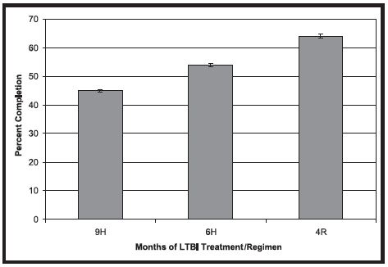
Shorter regimens appear to be associated with increased completion rates
Horsburgh CR Chest 2010:137:401-09

Slide 13
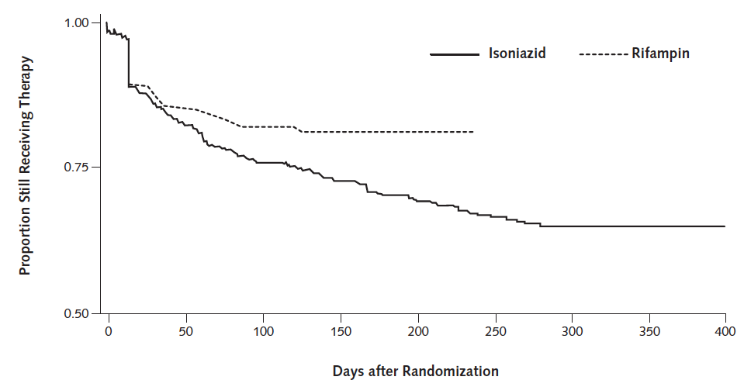
Completion with 4R compared to 9H: a randomized trial of 847 patients
78% completed 4R
60% completed 9H
Menzies et al. Ann Int Med 2008;149:689-697

Slide 14
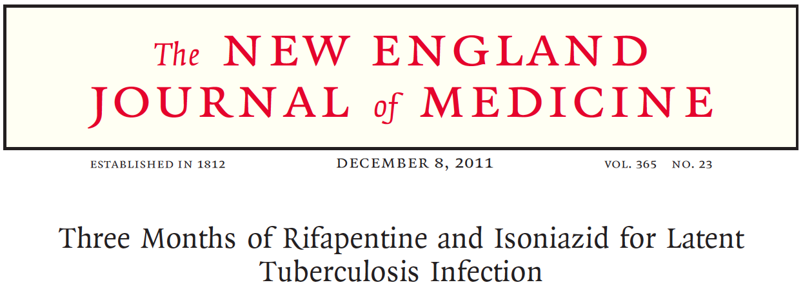
New Option for LTBI Treatment
12 weekly doses of Isoniazid/Rifapentine (INH/RPT) with directly observed therapy (DOT)
Based on review of randomized clinical trial and two other studies:
  As effective as INH for 9 months
  More likely to be completed
CDC Recommendations in December 9, 2011
MMWR 2011; Vol 60 No. 48

Slide 15
TBTC Study 26, PREVENT-TB:
A randomized, controlled trial of two regimens for treatment of LTBI
Patients with LTBI at high risk for reactivation
(mainly close contacts of active cases)
randomization
by household
9 months of daily
INH, self-
administered
(270 doses)
3 months of
once weekly INH and
rifapentine by DOT
(12 doses)
Study endpoint: development of active TB at 2 years

Slide 16
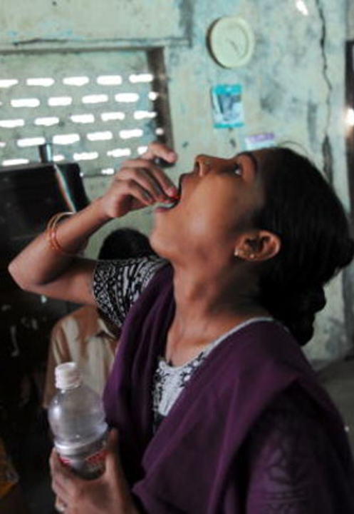
Primary Aim
Evaluate the effectiveness of weekly INH-RPT vs daily 9H
Primary endpoint:
Culture-confirmed TB in persons > 18 y.o. and culture-confirmed or clinical TB in persons < 18 y.o.
Notes:
20 % of patients will have LFT elevation

Slide 17
Secondary Aims
Evaluate the tolerability of weekly INH-RPT v. daily 9H
Secondary endpoints:
  Treatment completion
  Permanent drug discontinuation for any reason
  Drug discontinuation due to adverse drug reaction
  Grade 3, 4, and 5 toxicity
  Culture-confirmed or clinical TB in all persons
  Resistance to study medications among persons developing TB
Notes:
17
17

Slide 18
Clinical and Demographic Characteristics
MITT Population
Characteristic | 9H N=3,745 | INH-RPT N=3,986
Age (median, IQR) | 36 (25-46) | 37 (25-47)
Male sex | 2,004 (54) | 2,210 (55)
Race
White | 2,160 (58) | 2,296 (58)
Black | 947 (25) | 978 (25)
Asian/Pac. Island | 490 (13) | 494 (12)
Am./Can. Indian | 33 (1) | 84 (2)*
Multiracial (Brazil) | 115 (3) | 134 (3)
Ethnicity (US/Can)
Hispanic | 1,442 (43) | 1,576 (44)
Non-Hispanic | 1,899 (57) | 1,966 (56)
Notes:
18
18

Slide 19
Clinical and Demographic Characteristics
MITT Population
Characteristic | 9H N=3,745 | INH-RPT N=3,986
HIV-infected | 100 (3) | 105 (3)
BMI (median, IQR) | 27 (23-30) | 27 (23-31)
Site of recruitment
U.S./Canada | 3,341 (89) | 3,542 (89)
Brazil/Spain | 404 (11) | 444 (11)
Completed high school | 2,126 (57) | 2,269 (57)
Jail/prison ever | 175 (5) | 221 (6)
Unemployed | 390 (10) | 424 (11)
Hx EtOH at enrollment | 1,888 (50) | 1,929 (48)
Hx IDU at enrollment | 136 (4) | 149 (4)
Current tobacco | 1,034 (28) | 1,112 (28)
Notes:
19
19

Slide 20
Clinical and Demographic Characteristics
MITT Population
Characteristic | 9H N=3,745 | INH-RPT N=3,986
Indication for TLI
Close contact | 2,609 (70) | 2,857 (72)
Recent TST converter | 972 (26) | 953 (24)
HIV-infected | 74 (2) | 87 (2)
Fibrosis on CXR | 90 (2) | 89 (2)
Co-morbid liver disease
HCV | 97 (3) | 99 (3)
HBV | 60 (2) | 42 (1)
Notes:
20
20

Slide 21
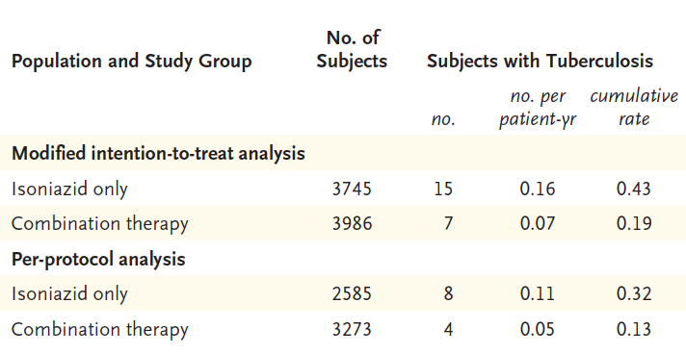
TBTC Study 26, PREVENT-TB:
Outcomes

Slide 22
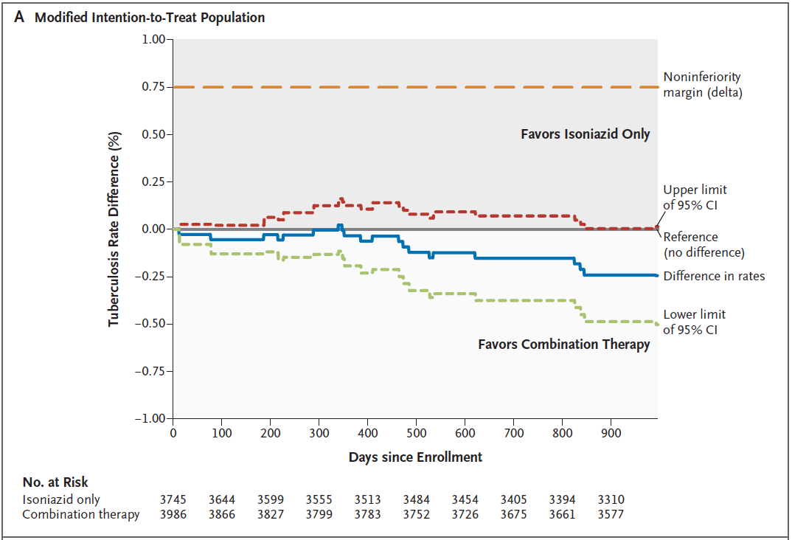

Slide 23
Cumulative TB Rate
33 months from enrollment—MITT
Log-rank P-value: 0.06
Notes:
23
23

Slide 24
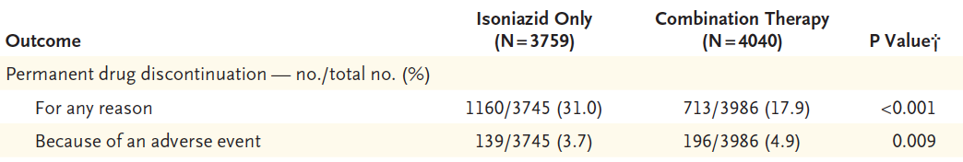
TBTC Study 26, PREVENT-TB : Adherence to therapy
69 %
completion
82 %
completion

Slide 25
Reported Adverse Events
Among persons receiving > 1 dose
During treatment or within 60 days of the last dose
Accounting for attribution to study drug
Toxicity | 9H N=3,759 | INH-RPT N=4,040 | P-value
Related to drug | 206 (5.5) | 328 (8.1) | <0.0001
Rash only | 17 (0.5) | 35 (0.9) | 0.02
Possible HS | 15 (0.4) | 158 (3.9) | <0.0001
Other | 71 (2.0) | 122 (3.0) | 0.001
Not related | 399 (10.3) | 220 (5.5) | <0.0001
HS: hypersensitivity reaction
Notes:
25
25

Slide 26
Hepatotoxicity
Among persons receiving > 1 dose
During treatment or within 60 days of the last dose
Toxicity | 9H N=3,759 | INH-RPT N=4,040 | P-value
All hepatotoxicity | 113 (3.0) | 24 (0.6) | <0.0001
Related to drug | 103 (2.7) | 18 (0.5) | <0.0001
Not related | 13 (0.4) | 6 (0.2) | 0.08
Notes:
26
26

Slide 27
INH/RPT – Recommended Groups
Healthy persons ≥12 years old with at least one risk factor for TB progression
  Recent known contacts to TB
  Conversion from negative to positive on a TST or IGRA
  Radiographic findings of healed pulmonary TB
  HIV-infected patients NOT on anti-retroviral therapy
Case by case basis for other patients (individuals unlikely to complete longer regimens “migrant farmworkers”)

Slide 28
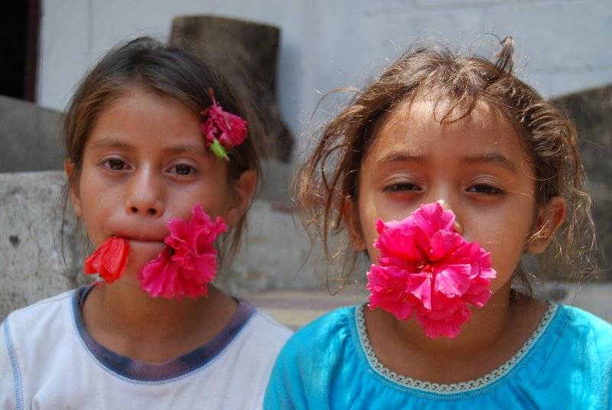
INH/RPT – Groups Not Recommended
Children < 2 years old
HIV-infected patients on antiretroviral therapy
Pregnant women
Patients exposed to TB resistant to either INH or rifampin

Slide 29
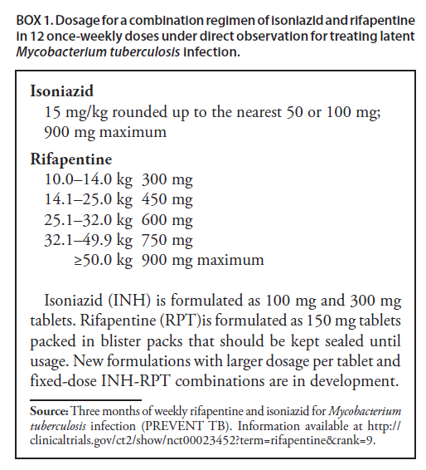
INH/RPT – Dosing/Cost
Drug costs (CT Dept. of Health; Lynn Sosa, MD)
  INH/RPT- $112 for 12 week course
  INH- $14 for 9 month course

Slide 30

Limitations
Few HIV-infected participants
  Tolerability and effectiveness data pending
Complete tolerability assessment in young children also pending
Notes:
30

Slide 31
TBTC Study 26, PREVENT-TB
Conclusions
INH-RPT was at least as effective as 9H
  The INH-RPT TB rate was approximately half that of 9H
INH-RPT completion rate was significantly higher than 9H
  82% vs. 69%
INH-RPT was safe relative to 9H
  Lower rates of:
    Any adverse event
    Hepatotoxicity attributable to study drug
Notes:
31

Slide 32
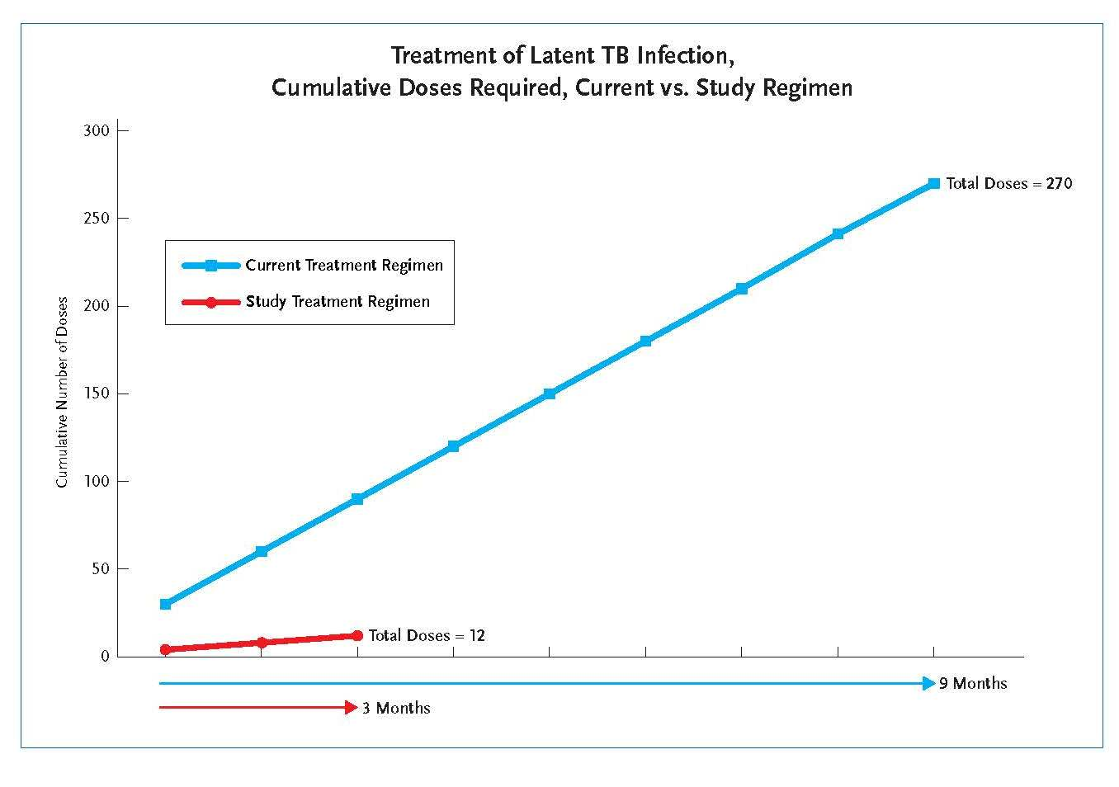
CDC, PREVENT TB Study, 2011

Slide 33
TBTC Study 26, PREVENT-TB
Conclusions
Permanent drug discontinuation due to adverse event was slightly higher in INH-RPT
  4.7% vs. 3.6%
Rates of any adverse event attributable to study drug also higher in INH-RPT
  8.1% vs. 5.5%
  This relationship also seen with rash, possible hypersensitivity
Rates of grade 3 and 4 toxicity did not differ by arm
Rates of death low (~ 1%) in both arms
Notes:
33

Slide 34
Interpretation
The higher rates of INH-RPT discontinuation due to an adverse event and adverse event attributable to study drug could be related to:
  Worse tolerability of INH-RPT
  More frequent interaction with study personnel
    Weekly in INH-RPT vs. monthly in 9H
  Open-label design with novel regimen
    Participants and investigators
Notes:
34

Slide 35
Do we really need DOT for INH-RPT?
Once a week regimen
  Ensure compliance
  Standard for all intermittent TB or LTBI treatment regimens
  Impact of missed doses on regimen effectiveness?
  Monitor for adverse effects
Self-administered INH-RPT is being studied
  TBTC Study 33 to address this: roughly 1100 patients randomized to DOT or self-administration with SMS reminders
    Study is ongoing
  Safety
CDC LTBI treatment adverse effects surveillance system
  (ltbidrugevents@cdc.gov, http://www.fda.gov/medwatch or 1-800-FDA-1088)
Notes:
YES

Slide 36
Bethlehem, PA Experience
“Increasing treatment completion of LTBI in high-risk international university students”*
Results:
  In fall 2012, 19 out of 20 (95%) students chose to be treated.
  Previously, in fall 2011 when the only treatment offered was 9 months of INH, 17 out of 44 (38.6%) students chose to be treated.
  Out of the 19 students who began the regimen, 13 (68.4%) students successfully took all 12 doses of the medication, completing the regimen. Of the 6 who did not complete, 3 stopped taking the medication due to adverse effects of medication and 3 were lost to follow up.
  Of the previous group of students who were only offered the 9 month INH regimen, 17 began treatment and 9 finished the full 9 months, for a completion rate of 52.9%.
*A. Anderson RN BSN1, S. Madeja RN MSN1 & L. Paulos RN MPH2
1 Bethlehem Health Bureau – Bethlehem, Pennsylvania 2 Maryland Department of Health and Mental Hygiene - Baltimore, Maryland

Slide 37
Bethlehem, PA Experience
“Increasing treatment completion of LTBI in high-risk international university students”*
Discussion:
  The new 12 week regimen has not only increased treatment completion from 52.9% to 68.4% but has also greatly increased the number of students who chose to initiate treatment from 38.6% to 95%.
  Requirements of directly observed therapy with the new regimen ensures students took each dose because each dose is observed by the nurse. Previously, the students were trusted to take each dose on their own and report when they missed a dose.
  High student satisfaction rates – 63% were either satisfied or very satisfied – indicates the regimen was viewed favorably.
*A. Anderson RN BSN1, S. Madeja RN MSN1 & L. Paulos RN MPH2
1 Bethlehem Health Bureau – Bethlehem, Pennsylvania 2 Maryland Department of Health and Mental Hygiene - Baltimore, Maryland

Slide 38
Completion of Therapy
Regimen | Duration | Doses | Complete Within
Daily INH | 9 months | 270 | 12 months
Twice weekly INH | 9 months | 76 | 12 months
Daily INH | 6 months | 180 | 9 months
Twice weekly INH | 6 months | 52 | 9 months
Rifampin | 4 months | 120 | 6 months
INH-RPT | 3 months | 11-12 | 16 weeks

Slide 39
Priorities in Screening and
Treatment of LTBI
With new tools for the diagnosis and treatment of LTBI, we now have a chance to improve the effectiveness of TB control in the US by focusing on cost-effective priorities
IGRA was cost saving compared with TST in certain groups
LTBI screening guidelines could make progress toward TB elimination by screening close contacts, HIV infected, foreign born regardless of time living in the US
Linas BP. Am J Respir Cri Care Med. 2011;184:590-601

Slide 40
Treatment of LTBI 2015: Conclusions
LTBI is common in the U.S.
Treatment of LTBI is an important component of TB elimination strategies
Important to choose treatment regimen based on individual circumstance of each patient
Treatment with the standard regimen of 9H is associated with very low adherence and significant rates of adverse events
Treatment with 4 months Rif is associated with much higher adherence and fewer serious side effects when compared to 9H
Regimen of INH-RPT is as efficacious as 9H, and when administered by DOT
Self-administration of INH-RPT will be tested in a randomized controlled TBTC trial

Slide 41
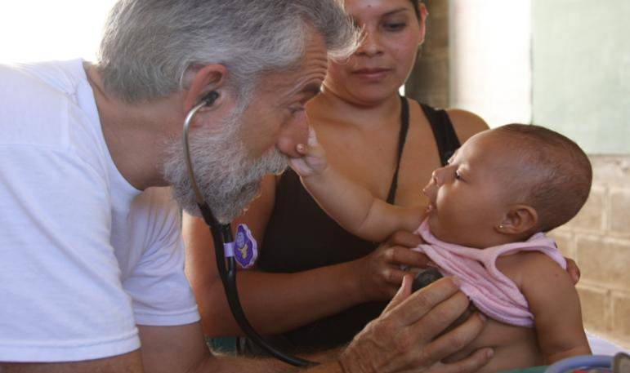
Contact
Ed Zuroweste, MD
kugelzur@migrantclinician.org

